Slide 1
Advanced Data Collection with MTurk
SIOP Master Tutorial
April 2018
Justin Wiegand, University of Illinois
Cory Kind, SHL

Slide 2
Roadmap
Intro
Mechanical Turk API
MTurkR Workflow and Example
TurkPrime Workflow and Example
Managing Your Reputation as a Requester
Q&A

Slide 3

Today’s Session
Purpose:
This session will provide tips and tricks to help extend MTurk’s capabilities. Topics include: (a) an introduction to the MTurk API, (b) a tutorial for using MTurk API tools for advanced data collection (e.g., longitudinal and dyadic data), and (c) how and why to manage your reputation as a Requester.
Intended Audience:
This session assumes some familiarity with the Mechanical Turk platform for data collection, usually through the Mechanical Turk website.
What we will share:
The deck and R code can be found here:
https://github.com/coryamanda/mturk_tutorial_siop18

Slide 4

What is your background with MTurk?

Slide 5

What is Mechanical Turk?
Mechanical Turk is a crowdsourcing/(“eLancing”) platform hosted by Amazon where workers complete tasks.
Most HITs are short (<10 minutes) and require skills like transcription, image classification, and data entry.
Longer HITs range up to 3-4 hours and can include surveys, A/B testing, user testing of websites, etc.
In MTurk, tasks are called “HITs” – Human Intelligence Tasks

Slide 6

How does it work?
Requester reviews the submitted HITs and decides if they are completed properly. Any HITs that are not “Rejected” within some time limit are automatically “Approved”.
Requester creates a HIT, specifying the task to be completed, the compensation, etc. and makes it available on MTurk
Requester
(you)
Timeline of a HIT
Workers log on to MTurk and “accept” HITs they want to complete
Within the time allotted, the workers complete the HIT and “submit” it back to the requester.
Workers

Slide 7
Motivation
MTurk can be very valuable for researchers.
However, data collection can be laborious and repetitive, particularly for certain use cases (contacting workers, assigning bonuses, managing qualifications).
Using the API (through R or TurkPrime) can mean less repetitive work for researchers, faster payments for respondents, and is cheaper to complete overall. Win-win!

Slide 8
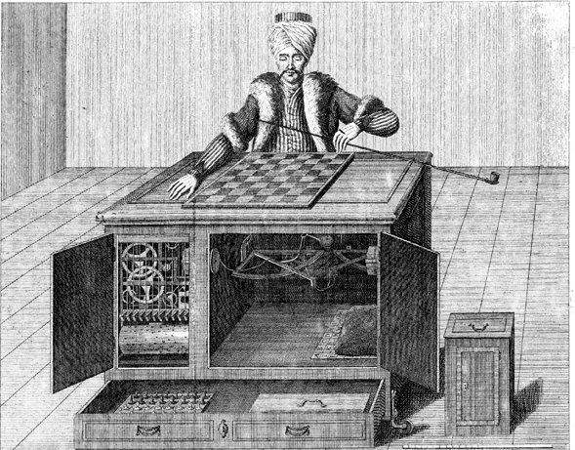
“Artificial Artificial Intelligence”
Based on the “Automaton Chess Player” exhibited in Europe and the Americas in late 18th century
“Technological marvel”… powered by humans.

Slide 9
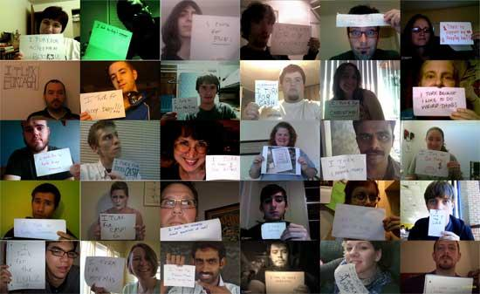
MTurk Today
Source: http://waxy.org/2008/11/the_faces_of_mechanical_turk/

Slide 10
Mechanical Turk API

Slide 11
Key Definitions
Amazon MTurk web interface:
The “point and click” user interface used to create and manage HITs on requester.mturk.com
MTurk API
The commands and protocols that allow users and systems to interact with MTurk programmatically rather than directly on the MTurk web interface
MTurkR package
An open-source wrapper package allowing R users to easily use the MTurk API via familiar R tools
TurkPrime
A commercial platform that uses (and builds) on the API offered by MTurk and provides a “point and click” interface

Slide 12
API Basics
An application-programming interface (API) is a defined set of communication that a programmer can use to access a software application.
APIs allow you to request a limited set of information – only the information that the API is designed to allow.
For instance:
A local gym might let users sign up for a class and then download that information directly to their Google Calendar
Twitter lets researchers and journalists download a limited number of tweets per day for free
Request for information + user’s ID
User
Host (MTurk)
Response

Slide 13
MTurkR Workflow and Example

Slide 14

Getting Set Up with AWS
To identify yourself to MTurk via the API, you need two identifiers that are unique to you. MTurkR will automatically pass these to the API every time you make a request.
MTurk provides you these when you sign up with an Amazon Web Services account.
Sample access key ID
Sample secret access key
To check if it worked, try checking your AccountBalance()
Update these with your own details.

Slide 15
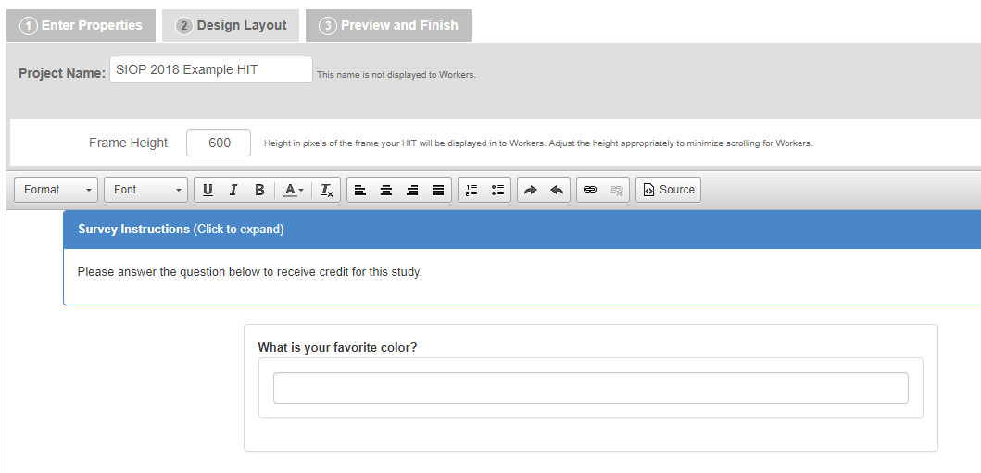
Design a HIT in MTurk
There are several ways to create HITs, including with the API. In general, I prefer designing HITs in MTurk first so I can see the layout and formatting.

Slide 16
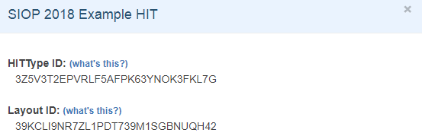

Create a HIT
Look up the HIT Type ID and Layout ID in the “Create” tab (these are automatically generated)
Then tell the API to launch the HIT you designed.
Use the HIT Type and Layout ID from the HIT you designed.
Time is given in seconds.

Slide 17

Check Status
CreateHIT will return a HIT ID – a unique identifier for that specific HIT. Use this to refer to it in the future.
You can check the fill or expiry status of your HIT using HITStatus().

Slide 18
Download Responses
Use GetAssignment to download all of the submissions of your HIT to a dataframe.
mydata now contains one row for each submitted HIT. The columns include:
Unique IDs for each Assignment and Worker
Current status (“Submitted”, “Approved”, or “Rejected”)
Metadata (how long the Worker spent on the HIT, Accept Time, Auto Approval Time, etc.)
Their response to the questions (e.g., favorite color)

Slide 19


Approve or Reject Assignments
These are all valid responses.
Now we can approve the assignments using the AssignmentIDs provided in the dataframe.
By default, the API prints out confirmation your activity. You can change this optional parameter if you want.

Slide 20
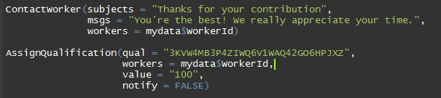
Contact and/or Qualify Workers
WorkerIDs can be used to bulk contact the Workers or to give them qualifications. Qualifications are helpful for managing Workers in longitudinal studies, maintaining a pool of respondents, or avoiding duplicates in future related studies.

Slide 21
Example MTurk Commands
Managing Workers AssignQualification ContactWorker WorkerReport | Managing Assignments ApproveAssignment RejectAssignment
Managing Qualifications CreateQualificationType GrantQualification RevokeQualification | Managing HITs BulkCreate CreateHIT ExtendHIT ExpireHIT
Other AccountBalance readlogfile

Slide 22

TurkPrime Workflow and Example
Notes:
25 minutes total for this section.
[For title slide]
I’m Justin Wiegand, a PhD Candidate at the University of Illinois’ School of Labor and Employment Relations.
[Current slide]
I have used the R package to collect longitudinal MTURK data and it is excellent and 100% free. I wrote a series of blog posts on its use (justinwiegand.com/blog).
However, for those who prefer something more point and click and some additional features, TurkPrime is a great solution. Its core features are free to academics and always low cost. There’s even the ability to save money using hyper/micro-batching (more on that later).
Before going any farther,
I want to be clear that I have no affiliation or sponsorship from TurkPrime, although maybe they should pay me, I am a satisfied user.
Also, how many of you have used TurkPrime?
If a lot have used it, go through the general overview faster and focus on longitudinal data and batching.

Slide 23
TurkPrime Example Agenda
Platform
Setting up a HIT (“Human Intelligence Task”)
Demographic Panels
Micro/HyperBatching
Longitudinal data collection and bulk emailing workers
Notes:
If there’s time, I can also cover a scripted solution to Dyadic data collection.

Slide 24
TurkPrime
Platform and HIT Setup
Notes:
Example Script and Flow:
Login
Add AWS Credentials
Setup a Study
Design Study > MTurk toolkit (note that a fully managed MTurk study can be done without the need to link to the MTurk API/have an MTurk account)
Run a study on your own MTurk account
Pages
Create a “Study Link” project
Select # of participants.
Show all the demographics options that range from $0.15-$0.75/Worker submission. Solicit a few demographics options from the crowd.
Notably, the MTurk web interface recently started offering demographic data options as well. They typically range from 30 to 50 cents (complete range is 5 cents to $1). TurkPrime is generally cheaper, especially if you plan to use multiple demographic categories as your costs never exceed 75 cents/worker.
Enter your own Project Name (not displayed) and up to 5 email addresses for HIT updates (e.g., launch, completion)
Enter MTURK details (this corresponds to what MTURK asks of you:
Name (displayed)
Description: Complete a ~30 minute survey on your interests, work activities, and job satisfaction.
Custom instructions (best practice is to reserve these for your survey landing page).
Standard instructions that workers should follow the hyperlink and submit a code (if set) are always included and will follow the custom instructions, if specified.
Keywords (important for worker searches)
Enter:
how much to pay each respondent
the estimated time to complete
time allotted (keep 90 or less minutes if at all possible to allow for restart feature—this allows respondents already in the old HIT to finish and then restarts your survey with any changes)
Your survey link and be sure to click preview to verify it works!
Note the optional demographics button at the bottom—you may want to uncheck it.
Approval Options:
Custom w/manual approval. My preferred method. I generate random codes in the survey and verify them.
Easier options exist allowing auto approval:
Fixed completion code (may be a security risk, but it is a simple option)
Qualtrics dynamic code. I have not used this option, but it looks straight-forward and the instructions are on the HIT set up page.
Your HIT can either be auto-approved or manually approved.
Worker Requirements provides some excellent FREE options and is great for creating a longitudinal data set even if you did not intend to in your first wave of data collection!
Exclude or allow ONLY workers completing your previous surveys OR survey groups.
Select FREE worker qualifications (these are independent of the panel qualifications in step one). This is good for selecting which country respondents are from for FREE.
Microbatch profeature: Not sure why it has its own page. Probably a remnant of when it was a free feature. I’ll skip as I prefer Hyperbatch, same price but everything is better. More to come.
Profeatures including Hyperbatching!
Apart from Panel Fees, all profeatures are the same price. If you use on feature, you can use all. One feature saves time AND money over normal MTurk. So I recommend you click it and then use any other features you might need.
That feature is “HyperBatching” It divides your survey up into groups of 9 and sets up worker groups so that workers can not take more than one iteration of your survey. These batches complete faster than just a single link to your survey and it saves money by getting into a lower price point on MTurk (more on the next slide).
Apart from Hyperbatching:
Block Duplicate IP Addresses (not available if you don’t allow TurkPrime to store IP addresses)
Verify Worker Country and State Location
Anonymize Worker IDs (good for IRB approval; there’s no identifier in the data then if you also don’t collect IP addresses)
Setup Worker Groups:
Good for longitudinal data or quasi experiments where you don’t want folks in one group able to take a survey.
Each survey you run is saved as a group for free.
Groups are helpful for effectively combining multiple HITs into one selectable group (perhaps for later follow-up)
Choose from US regions (this is IP address based I believe)
Don’t collect IP addresses
That’s it! Save and then you can review, modify, and launch from your TurkPrime Dashboard.

Slide 25
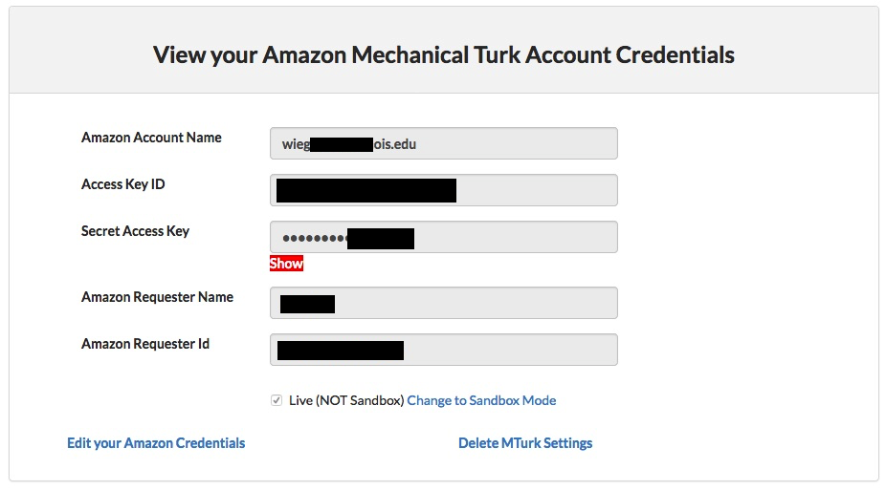
Adding MTurk Account and Amazon API Keys to TurkPrime
Notes:
First, note that you can hire TurkPrime to run your study without an MTurk account and without using the MTurk API, but it will cost more and there usually isn’t a good reason to. The whole TurkPrime platform is user-friendly and intuitive. And, you can only directly contact workers if you set up your account to use the API.
Get your Access Key and ID via Amazon Web Services.
Then, in TurkPrime, click on your username > “Mechanical Turk Account” > add your Amazon Web Services Credentials

Slide 26
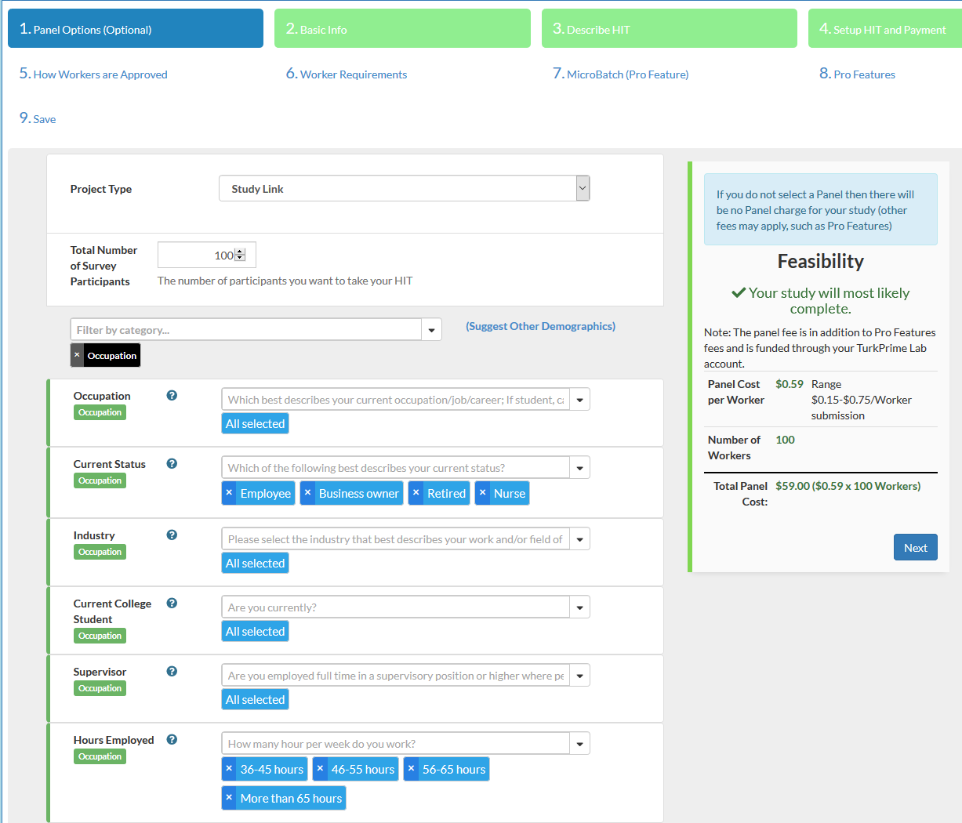

Slide 27
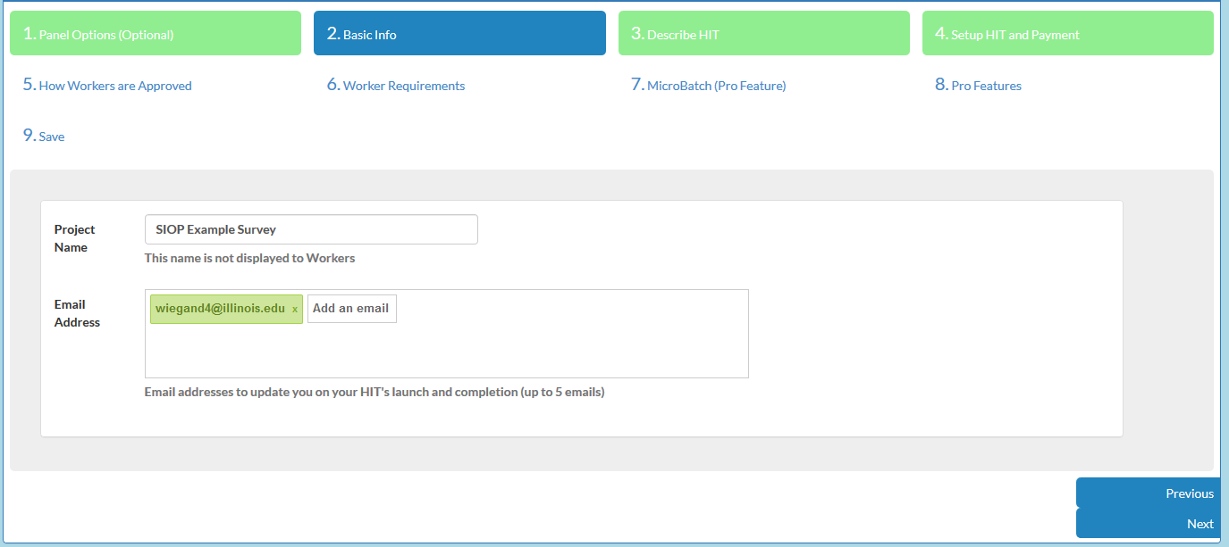

Slide 28
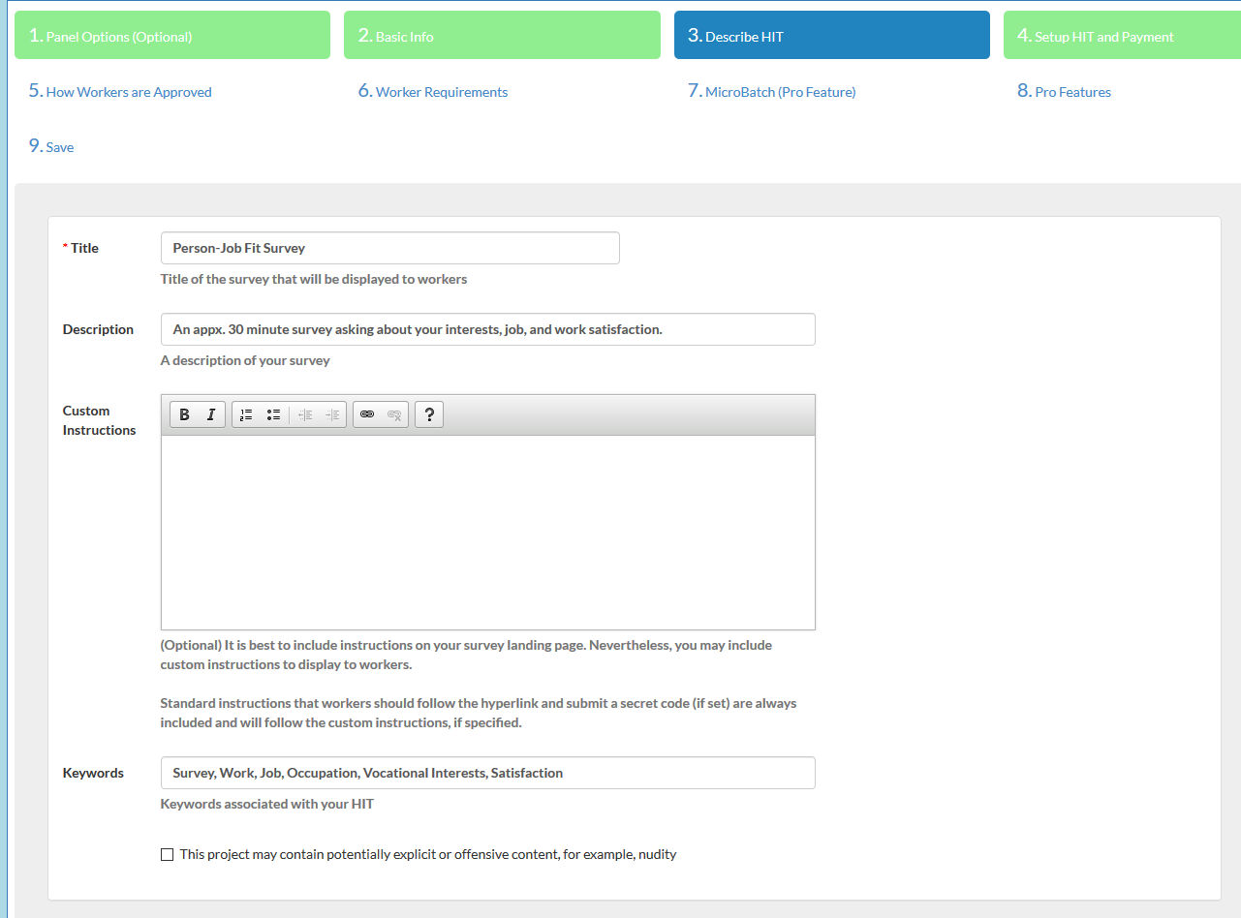

Slide 29
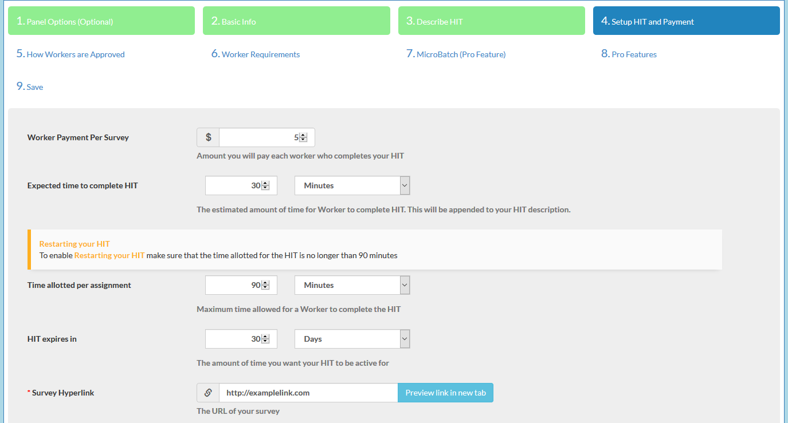

Slide 30
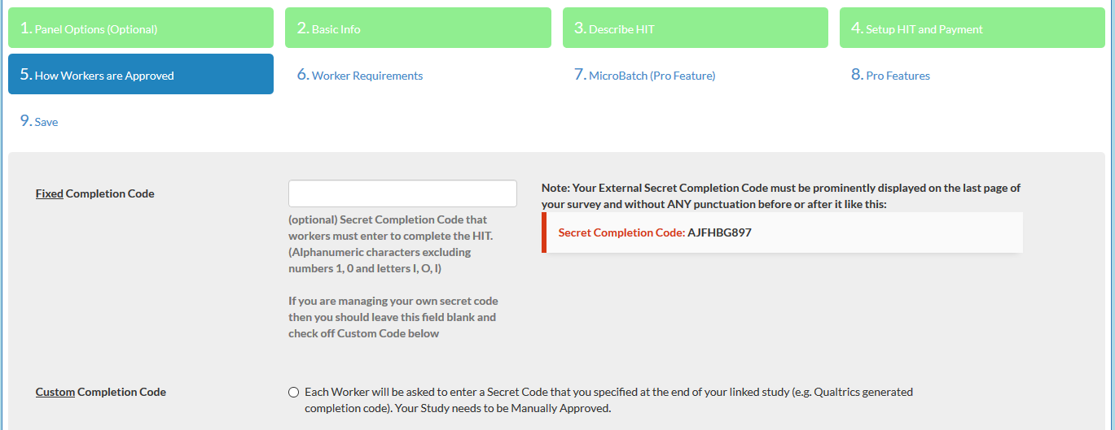

Slide 31
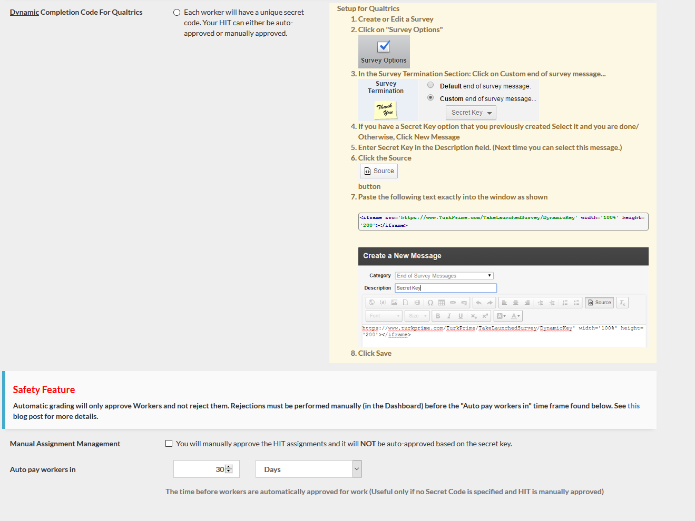
Notes:
5. Continued

Slide 32
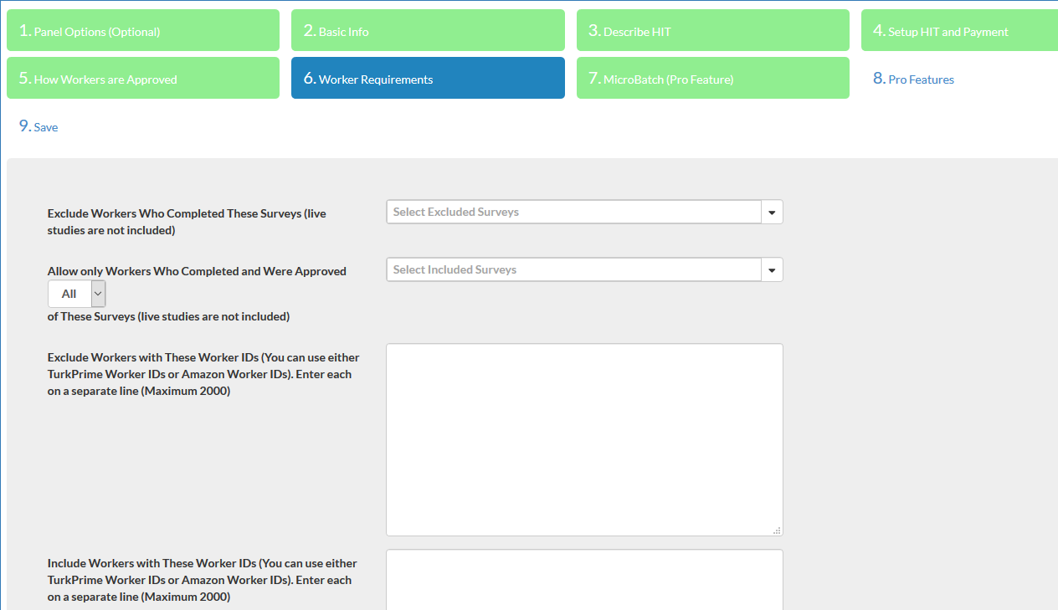

Slide 33
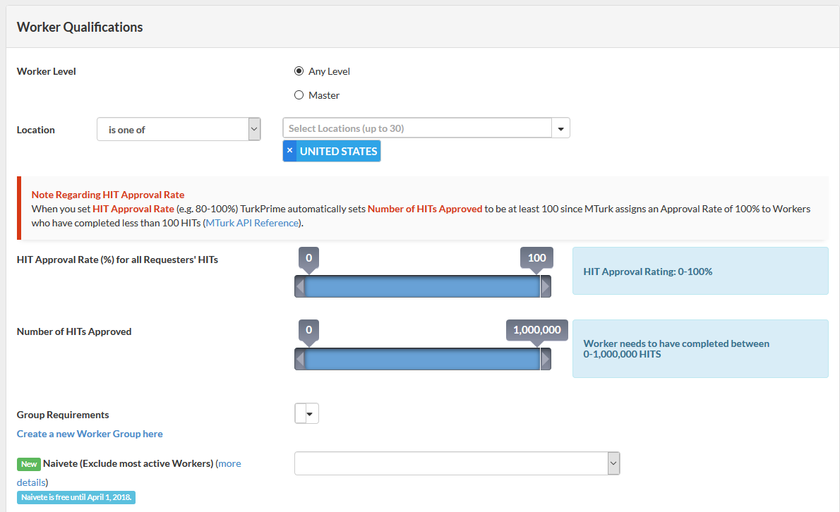

Slide 34
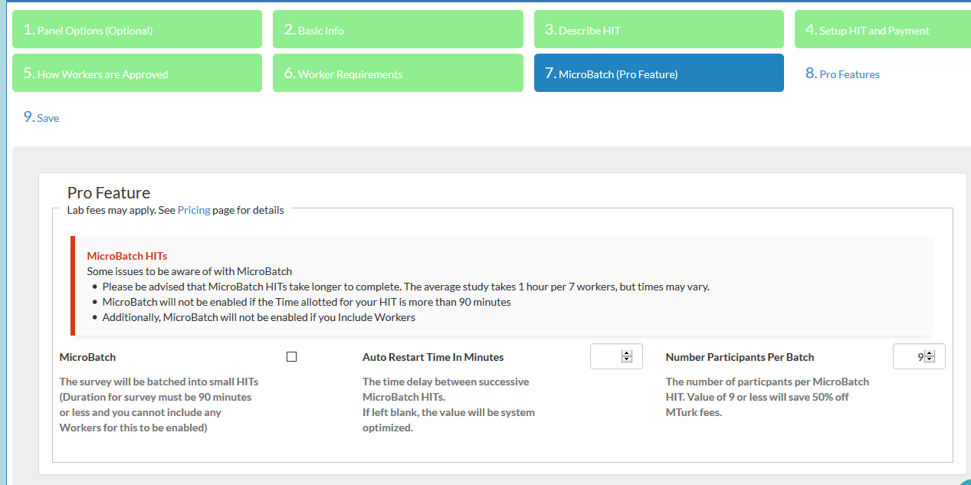

Slide 35
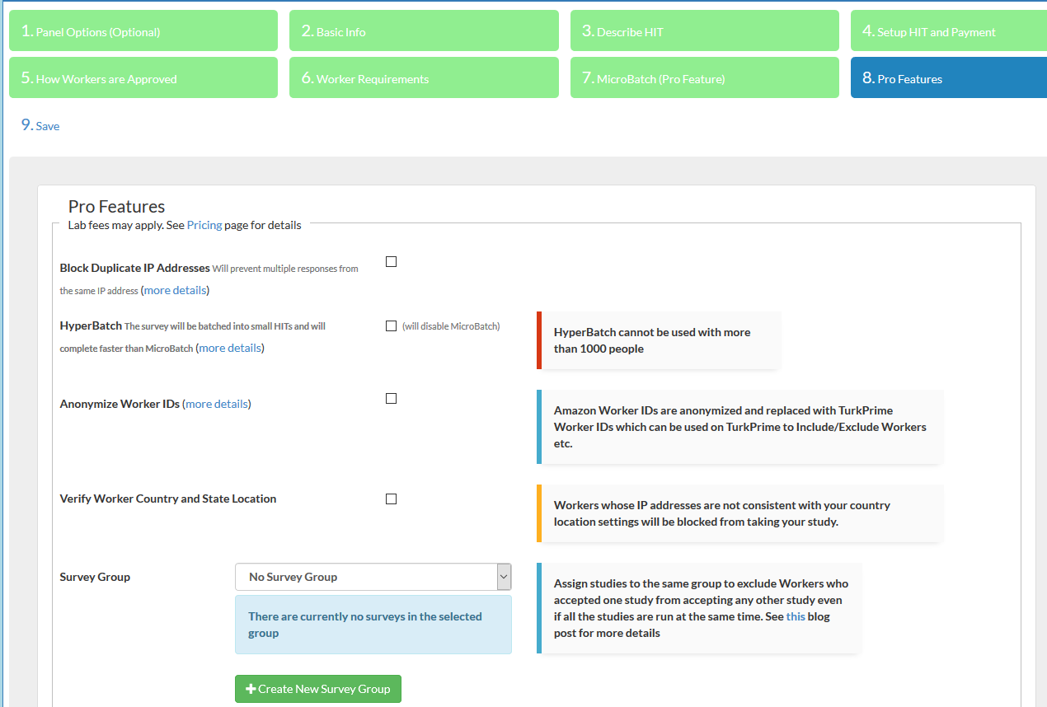

Slide 36
Micro/Hyper-Batching
9 workers
9 workers
9 workers

Slide 37
Micro/Hyper-Batching Cost Comparison
Base MTurk
(100 Workers; $5 each)
Amount Paid Workers: $500
Amazon Cost: $200 (40% for 10 or more workers)
TurkPrime Micro/HyperBatch
(100 Workers; $5 each)
Amount Paid Workers: $500
Amazon Cost: $100 (20% for batches of 9 workers)
TurkPrime Lab Fees for Pro Features: $27 ($.02 per worker + 5%)
Total:
$700
Total:
$627 (Academic)
$635 (Business) (see below)
*Note: I’m using Academic pricing.
TurkPrime Lab Fees for Businesses: $.05 per worker + 6% = $35
Notes:
If you use 10 or more workers the Amazon fee is 40%. In such cases, you will always save money by using HyperBatch (or MicroBatch).
HyperBatch
Divides your HIT into 9 assignment HITs that are released at the same time, but block workers from taking more than one HIT. The results are culled together in the exact same way as if you released the entire HIT at once.
In my own experience, the HyperBatching completed 2.5x faster than a normal run.
I first ran a normal run of 50, then a HyperBatch of 50
Microbatch is now a pro feature as well. Not worth it unless you’re running a small study/time no matter at all
Hyperbatch also allows you to use all other premium features

Slide 38
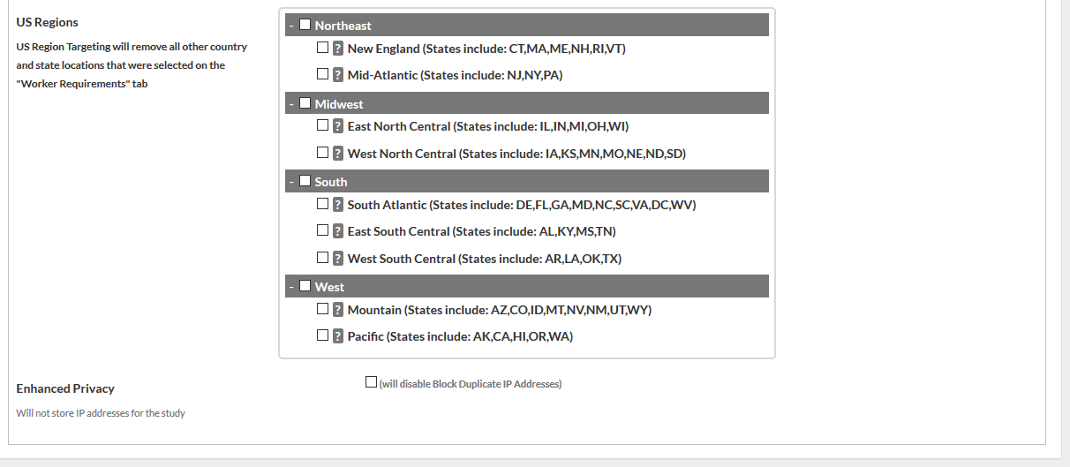
Notes:
8. Continued.

Slide 39
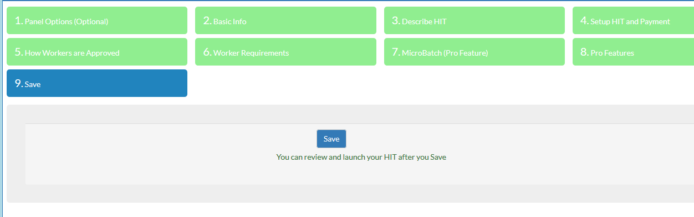

Slide 40
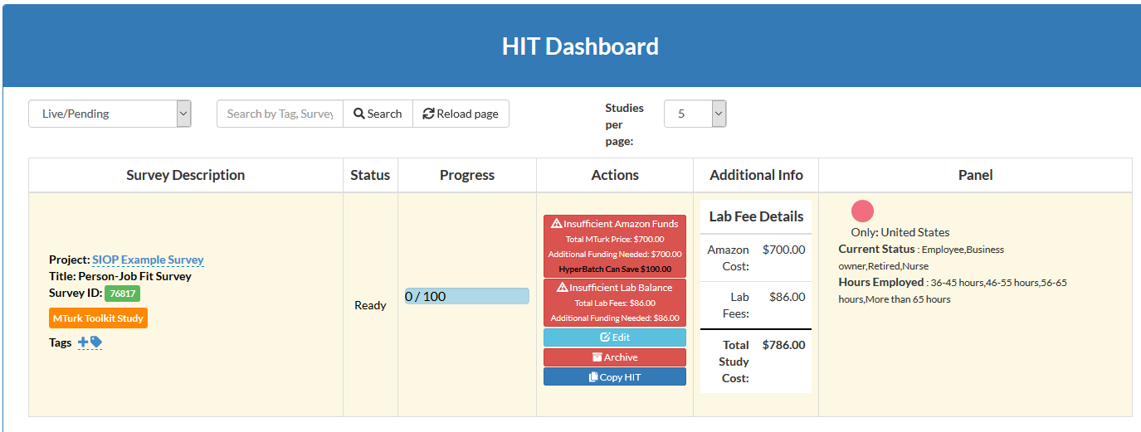

Slide 41
Longitudinal Data Collection Issues
Qualifying the MTurk Worker Pool
Notifying Workers of your follow-up survey(s)
Notes:
Very easy.
After reading: we're going to have unique WorkerIDs in our dataset so we can match on WorkerIDs and then de-identify the dataset.

Slide 42
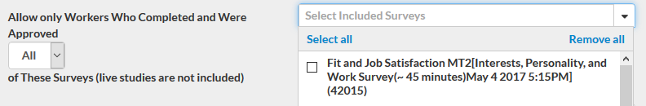
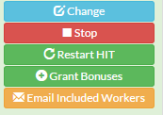
Longitudinal Data Collection Issues
Use “Include Workers” feature (in Step 6) to limit Workers
Include workers by specifying the HIT they previously took (simplest)
–or–
Include workers by specifying the Worker ID
Once you launch, notify workers from the TurkPrime dashboard:
Notes:
If we created a survey group, we could also use that.

Slide 43
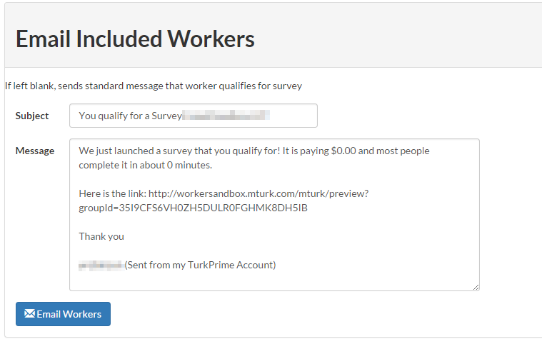
Form for Notifying Workers
Image from: http://feedback.turkprime.com/knowledgebase/articles/612606-longitudinal-follow-up-surveys
Notes:
TurkPrime claims that an invitation email for a well paying HIT will speed up HIT participation rate by a factor of 10 times!
A HIT that would normally take 10 days to complete will complete in one day!
You can also exclude workers by WorkerID.

Slide 44

Motivation
 | Amazon User Interface | MTurkR package | TurkPrime
Design and launch HITs
Target Workers by demographics
Qualify workers in bulk
Contact workers in bulk
Extend time or # respondents in a HIT
Micro- or hyper -batching
Auto approval of dynamic completion codes

Slide 45
Managing Your Reputation as a Requester
Notes:
25 minutes total for this section.
[For title slide]
I’m Justin Wiegand, a PhD Candidate at the University of Illinois’ School of Labor and Employment Relations.
[Current slide]
I have used the R package to collect longitudinal MTURK data and it is excellent and 100% free. I wrote a series of blog posts on its use (justinwiegand.com/blog).
However, for those who prefer something more point and click and some additional features, TurkPrime is a great solution. Its core features are free to academics and always low cost. There’s even the ability to save money using hyper/micro-batching (more on that later).
Before going any farther,
I want to be clear that I have no affiliation or sponsorship from TurkPrime, although maybe they should pay me, I am a satisfied user.
Also, how many of you have used TurkPrime?
If a lot have used it, go through the general overview faster and focus on longitudinal data and batching.

Slide 46
Why Be a Good Requester
Workers communicate – they will encourage others to complete your HITs
High quality data – people put in more effort for Requesters they respect
Enables a “pool” model – using the same workers in multiple studies allows you to build more complex profiles of respondents (i.e., answers to multiple assessments + longitudinal data)
Low drop-off rates – it costs time and money to build a pool. Using the same workers multiple times means less money spent on additional screening.
Finish faster - fill times drop when Workers want to work for you

Slide 47
How to Keep Workers Happy
Non-Pay Options
Give them a long response window to let them plan their schedule (ideally multiple days)
Respond promptly to submissions (and emails)
Thank them for their time and position their contributions as a contribution to your research
When applicable, consider offering non-monetary compensation (for instance, assessment results)
Make sure your technology works (avoid service windows)
Always do a pilot first (pro-tip: offer pilot users an extra $0.25 for constructive feedback)
Do NOT block Workers unless you have good reason
Contact Workers directly to let them know first about new studies
Reject when necessary, but let them know you’ll “Accept” the HIT if they fix the problem. Particularly when it could have been a simple mistake.
Follow the Guidelines for Academic Requesters here: http://wiki.wearedynamo.org/index.php/Guidelines_for_Academic_Requesters

Slide 48
Keeping Workers Happy
Pay Options
Avoid unpaid screeners (filtering people as unqualified after the study has started)
Use pay strategically to increase engagement. For instance, offer a bonus for high performance on a cognitive reasoning assessment.
If you’re doing longitudinal collection, increase your pay rate in subsequent stages.
In general, paying a fair wage helps ensure quality responses.

Slide 49
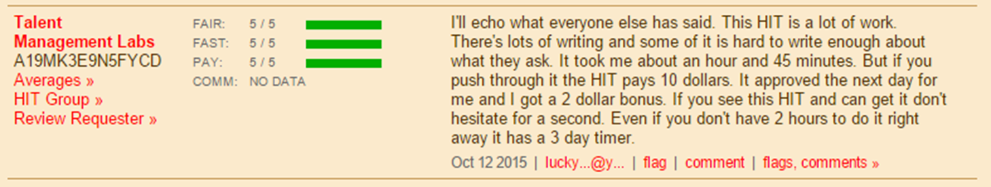
TurkOpticon
Link: https://turkopticon.ucsd.edu/
Hosted as a way for Workers to let each other know which HITs (and Requesters) to avoid
Useful for understanding if and why Workers are unhappy
Having a good reputation means more people are willing to participate in your surveys – you can also reach out to those people again
NOTE: Depending on your study design, it may also be important to monitor communication about the HIT between Workers.

Slide 50
Resources and Q&A
Notes:
25 minutes total for this section.
[For title slide]
I’m Justin Wiegand, a PhD Candidate at the University of Illinois’ School of Labor and Employment Relations.
[Current slide]
I have used the R package to collect longitudinal MTURK data and it is excellent and 100% free. I wrote a series of blog posts on its use (justinwiegand.com/blog).
However, for those who prefer something more point and click and some additional features, TurkPrime is a great solution. Its core features are free to academics and always low cost. There’s even the ability to save money using hyper/micro-batching (more on that later).
Before going any farther,
I want to be clear that I have no affiliation or sponsorship from TurkPrime, although maybe they should pay me, I am a satisfied user.
Also, how many of you have used TurkPrime?
If a lot have used it, go through the general overview faster and focus on longitudinal data and batching.

Slide 51
Linked Resources
Resource | Link
Cory’s GitHub | https://github.com/coryamanda/mturk_tutorial_siop18
Justin’s Blog | justinwiegand.com/blog/?p=440
MTurkR Documentation | https://cran.r-project.org/web/packages/MTurkR/MTurkR.pdf
MTurkR Wiki (lots of practical examples) | https://github.com/cloudyr/MTurkR/wiki
Amazon Mechanical Turk Getting Set Up Guide | https://docs.aws.amazon.com/AWSMechTurk/latest/AWSMechanicalTurkGettingStartedGuide/SetUp.html
TurkPrime | https://www.turkprime.com/
TurkOpticon | https://turkopticon.ucsd.edu/
TurkerNation | http://turkernation.com/

Slide 52
Justin Wiegand
Cory Kind
University of Illinois
SHL
wiegand4@Illinois.edu
corykind@shl.com

Slide 53
Appendix

Slide 54

Collecting Dyadic Data in MTurk (Overview)
Generate and save a random code in your survey.
Collect respondents’ dyad information (e.g., name and email address) and permission to contact the new dyad member.
Create an email notification including:
The random code from the original member survey
An invitation and link to complete your linked (additional/second) survey
Start the new dyad member’s survey by requiring respondents to enter the emailed code.
Use the random code to link dyad responses in your data collection.
Consider offering a bonus to Workers whose dyad member completes their survey and/or directly paying the dyad member.
Always operate within MTurk’s terms of service.
For complete copy/paste instructions using LimeSurvey (open source), visit: justinwiegand.com/blog/?p=440
Notes:
Use spouse as an example so we don't need to collect the name of the MTurk respondent.
The random code, name, and email are survey variables that you can call on in LimeSurvey.
Step 3
Cons:
The person isn’t paid.
Low response rate.

Slide 55
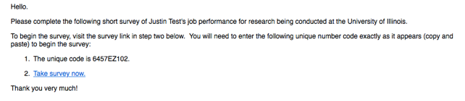
Example Email

